Slide 1
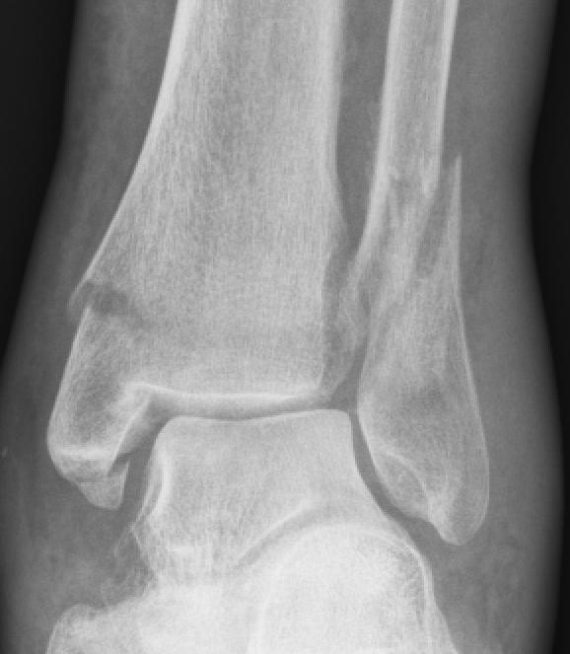
Muscle, Bone and Joint Injuries

Slide 2
Muscle, Bone and Joint Injuries
Have you ever suffered a fracture or dislocation?
What was the mechanism of injury?
(How did the injury happen?)
How was it cared for?

Slide 3
Students will be able to:
Identify various musculoskeletal injuries.
Identify signals of head, neck and back injuries.
Demonstrate how to care for head, neck and back injuries.
Demonstrate how to care for musculoskeletal injuries.

Slide 4
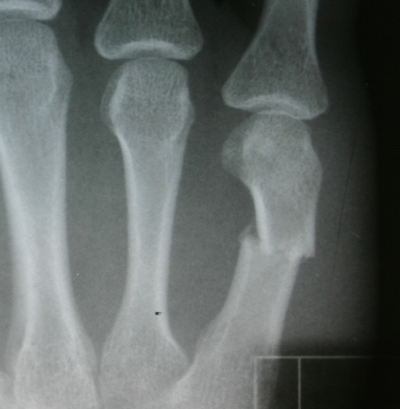
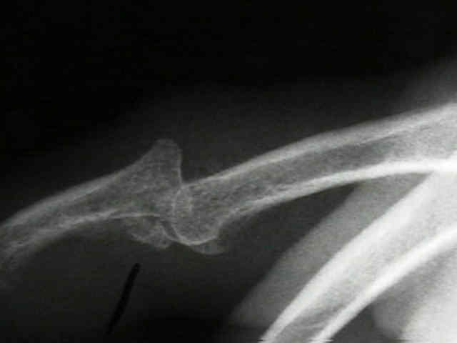
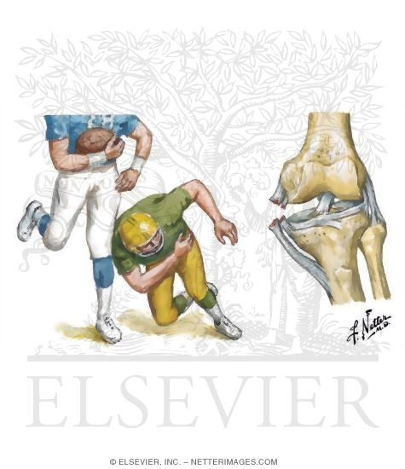
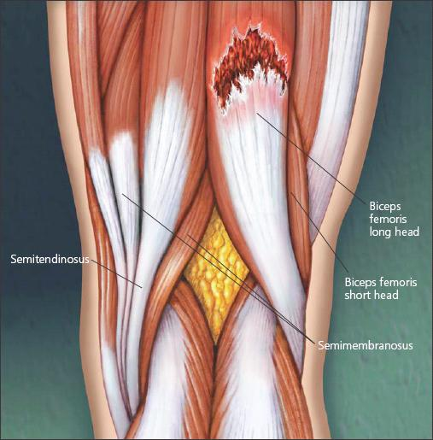
Categories
Fracture
Dislocation
Sprain
Strain

Slide 5
Terminology
Sprain
– stretch or tear of a ligament
What does a ligament connect?

Slide 6
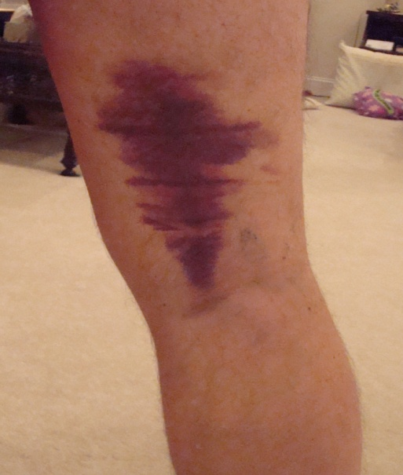
Terminology
Strain
– stretch or tear of a muscle or tendon

Slide 7
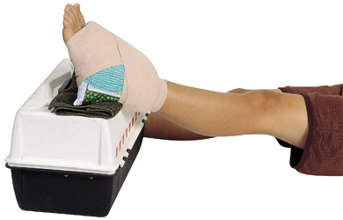
Treatment for Strains & Sprains
RICE
Rest
Ice
Compression
Elevation

Slide 8
Why Rice?
REST
- Avoids further damage
- Length of rest varies
ICE
-Slows down swelling
- Decreases local blood flow
- Decreases pain
Compression
-Helps control swelling
-Provides Support
Elevation
-limits swelling
- Encourages venous return

Slide 9
Terminology
Fracture
break or disruption of bone

Slide 10
Terminology
Dislocation
Disruption of joint where it becomes “Out of place”

Slide 11
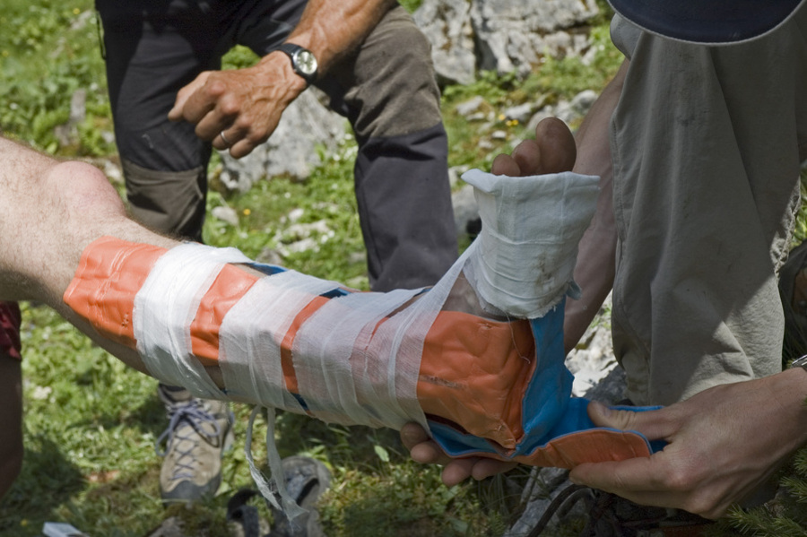
Treatment for Fractures & Dislocations
Splint
– a method of immobilizing an injury

Slide 12
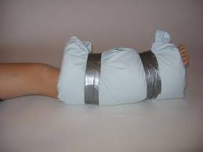
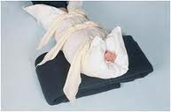
Splinting Methods
Soft Splinting
Use soft materials
Blanket, towel, pillow, jacket, etc

Slide 13
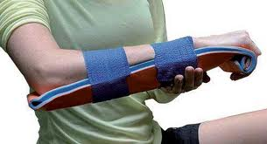
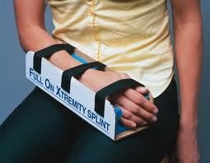
Splinting Methods
Rigid Splinting
Use hard materials
Boards, magazines, newspaper, cardboard, tree limbs, etc

Slide 14
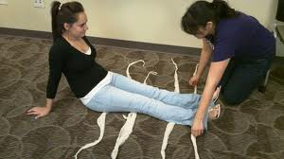
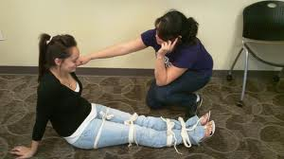
Splinting Methods
Anatomical Splinting
Use victim’s body or body part
Arm to chest
Leg to leg

Slide 15
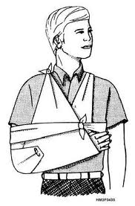
Splinting Methods
Sling & Swath
Use triangular bandages
Use on upper extremity
Sling on injured arm
Swath across chest

Slide 16
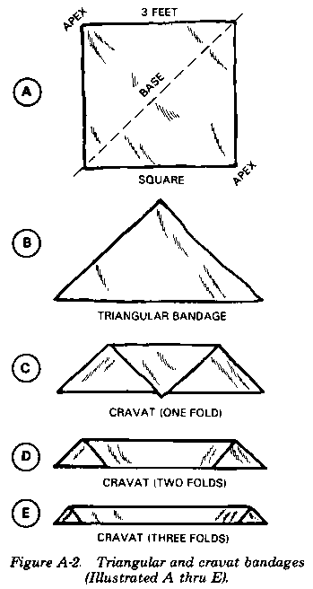
Cravat
– triangular bandage used to make a sling

Slide 17
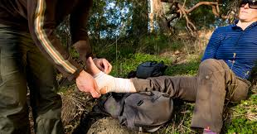
Care for Muscle, Bone & Joint Injuries
Check for signs of circulation (feeling warmth and color) after splint is applied
Splint should be snug but not cut off circulation
Splint body part in position you find it
Immobilize body parts above and below injury site

Slide 18
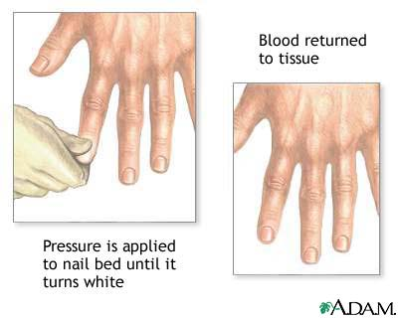
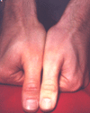
Signs of Circulation
Check for
Pulse
Feeling
Warmth of skin
Color of skin
Capillary refill

Slide 19
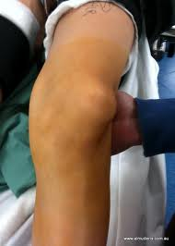
Determining the Severity
Sign
Any observable evidence of an injury
Deformity
Bruising or swelling
Inability to use the affected part normally
Bilateral Comparison
Mechanism of injury

Slide 20
Determining the Severity
Symptom
What the victim tells you about his or her condition
Feels bone grating
Heard or felt a “pop” or “snap” at time of injury
Pain Scale (1-10)
Numbness or tingling in extremity

Slide 21
What causes Head, Neck & Back Injuries?
Landing head first (diving into shallow pool)
Lifting objects
Falls, slips
Acts of violence
Sports Injuries
Motor vehicle accidents
Bike or motorcycle accidents (with or without helmets)
Fall from a height
Direct blow
Twisting mechanism

Slide 22
S & S of Head, Neck & Back Injuries
Change in consciousness
Numbness or tingling into hands or feet
Loss of movement in arms or legs
Breathing difficulty
Vision problems
Headache
Loss of balance
Blood from nose or ears or bleeding from head, neck or back
Unusual bumps or depressions on head, neck or back
Mechanism of injury leads you to believe there is head, neck or back injury
Neck or back pain

Slide 23
Care for Head, Neck & Back Injuries
Call 911
Minimize movement of victim (keep victim from moving by using your hands)
Monitor ABCs
Keep victim from becoming chilled or overheated
Be prepared to use lifesaving skills

Slide 24
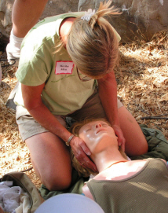
Methods in care for HNB injuries
Minimize movement of victim
Place hands on both sides of head
Hold persons head in line with spine
Support in position you found it

Slide 25
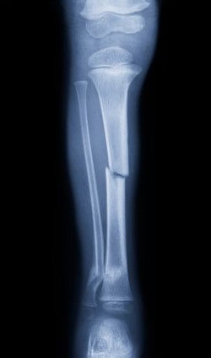
Minor vs. Severe Care
Minor-RICE: Rest, Ice Compression & Elevation
Severe- H-N-B Injury
Splint if:
You are not using EMS to move victim
You can do it without causing more pain

Slide 26
Videos
Sling & Swath - 3:22 - http://www.youtube.com/watch?v=49VBbHaXr8A
SAM splint - ankle - 2:41 - http://www.youtube.com/watch?v=pQj5xCOukZo&feature=related
Arm/wrist - 3:15 - http://www.youtube.com/watch?v=Ot7c3syPtr4&feature=related

Slide 27
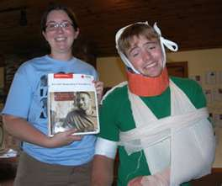
Let’s start Splinting!
Use Triangular Bandages
Sam Splint on ankle
Magazine on wrist
Sling & Swath

